Slide 1
Module 12: Revision
Enterprise Networking, Security, and Automation v7.0 (ENSA)

Slide 2
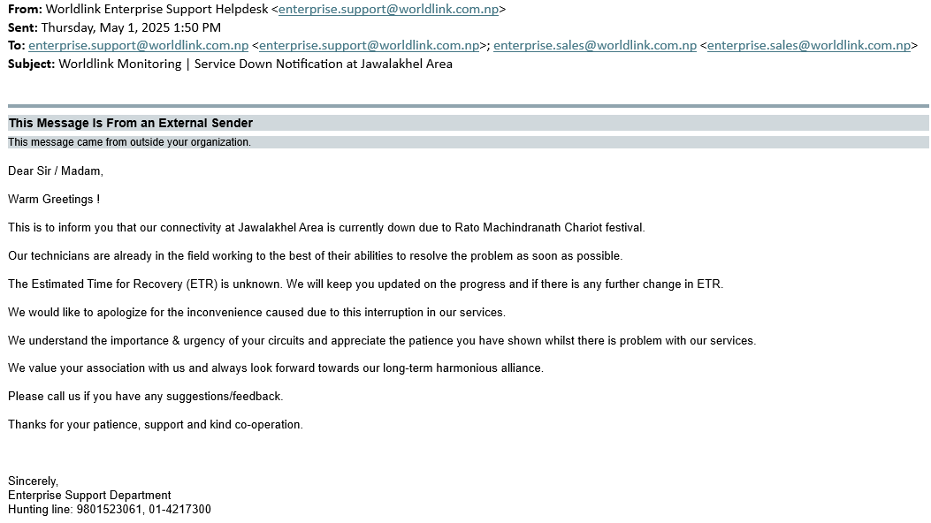
Recap
Recap
Open Shortest Path First (OSPF)
2.1 Establish Neighbor Adjacencies
2.2 Exchange Link-State Advertisements
2.3 Build the Link State Database
2.4 Execute the SPF Algorithm
2.5 Choose the Best Route
2.6 OSPF Reference Topology
2.7 Router ID Order of Precedence
3. ACL (Access Control List)
3.1 Wildcard Mask
3.2 Where to Place ACLs
4. NAT (Network Address Translation)
4.1 Static NAT
4.2 Dynamic NAT
4.3 PAT
4.4 PAT Interface
5. Summary

Slide 3
Open Shortest Path First (OSPF)
Recap
Open Shortest Path First (OSPF)
2.1 Establish Neighbor Adjacencies
2.2 Exchange Link-State Advertisements
2.3 Build the Link State Database
2.4 Execute the SPF Algorithm
2.5 Choose the Best Route
2.6 OSPF Reference Topology
2.7 Router ID Order of Precedence
3. ACL (Access Control List)
3.1 Wildcard Mask
3.2 Where to Place ACLs
4. NAT (Network Address Translation)
4.1 Static NAT
4.2 Dynamic NAT
4.3 PAT
4.4 PAT Interface
5. Summary
Open Source
Link-state Routing Protocol
Interior Gateway Protocol

Slide 4
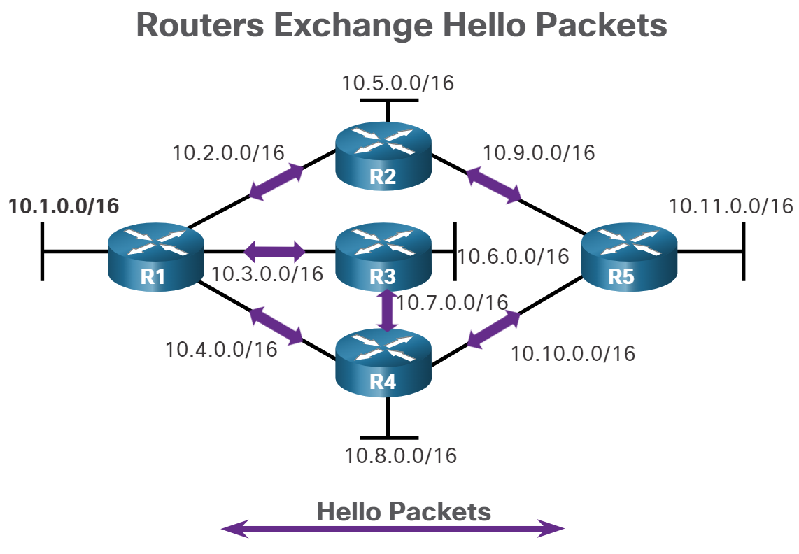
Establish Neighbor Adjacencies
Recap
Open Shortest Path First (OSPF)
2.1 Establish Neighbor Adjacencies
2.2 Exchange Link-State Advertisements
2.3 Build the Link State Database
2.4 Execute the SPF Algorithm
2.5 Choose the Best Route
2.6 OSPF Reference Topology
2.7 Router ID Order of Precedence
3. ACL (Access Control List)
3.1 Wildcard Mask
3.2 Where to Place ACLs
4. NAT (Network Address Translation)
4.1 Static NAT
4.2 Dynamic NAT
4.3 PAT
4.4 PAT Interface
5. Summary

Slide 5
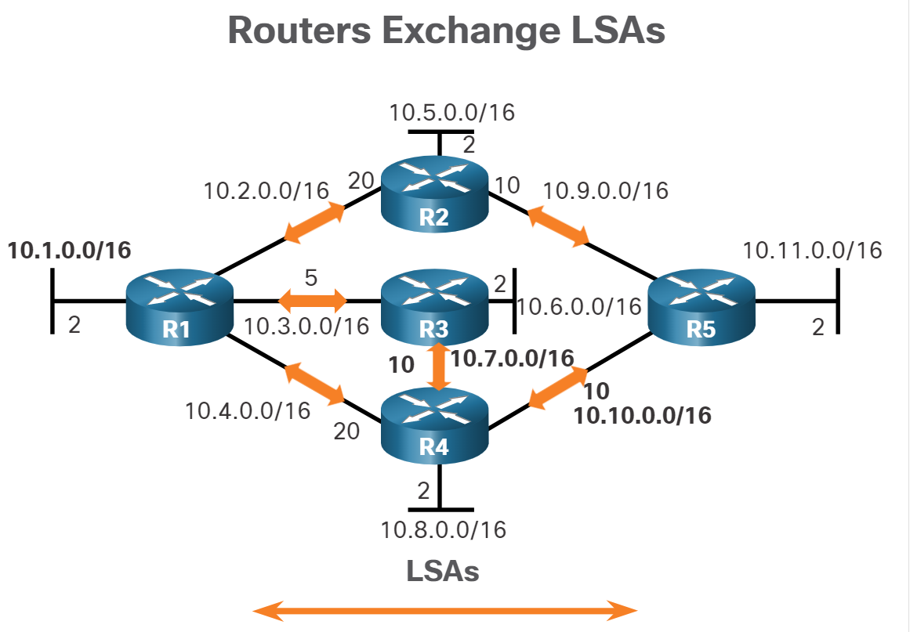
Exchange Link-State Advertisements
Recap
Open Shortest Path First (OSPF)
2.1 Establish Neighbor Adjacencies
2.2 Exchange Link-State Advertisements
2.3 Build the Link State Database
2.4 Execute the SPF Algorithm
2.5 Choose the Best Route
2.6 OSPF Reference Topology
2.7 Router ID Order of Precedence
3. ACL (Access Control List)
3.1 Wildcard Mask
3.2 Where to Place ACLs
4. NAT (Network Address Translation)
4.1 Static NAT
4.2 Dynamic NAT
4.3 PAT
4.4 PAT Interface
5. Summary

Slide 6
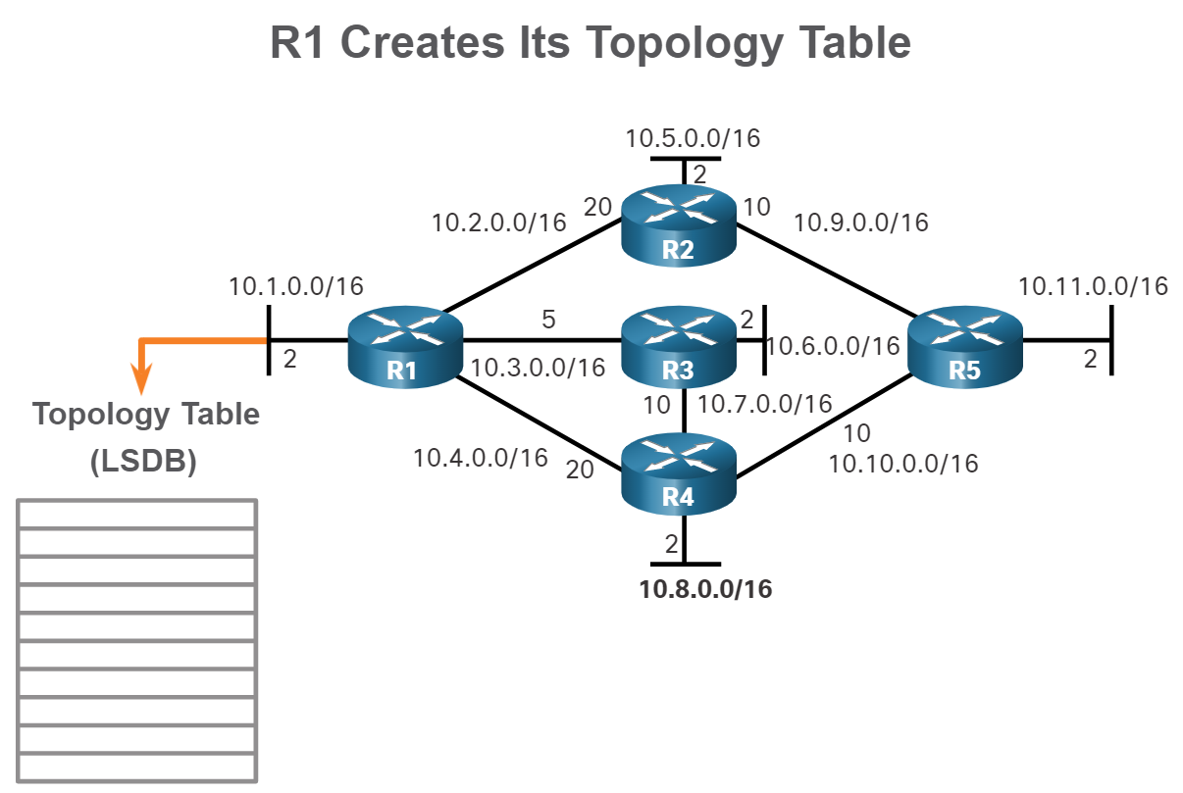
Build the Link State Database
Recap
Open Shortest Path First (OSPF)
2.1 Establish Neighbor Adjacencies
2.2 Exchange Link-State Advertisements
2.3 Build the Link State Database
2.4 Execute the SPF Algorithm
2.5 Choose the Best Route
2.6 OSPF Reference Topology
2.7 Router ID Order of Precedence
3. ACL (Access Control List)
3.1 Wildcard Mask
3.2 Where to Place ACLs
4. NAT (Network Address Translation)
4.1 Static NAT
4.2 Dynamic NAT
4.3 PAT
4.4 PAT Interface
5. Summary

Slide 7
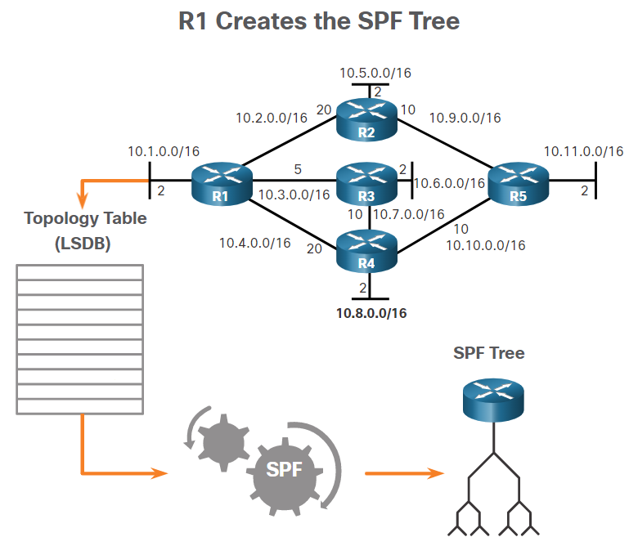
Execute the SPF Algorithm
Recap
Open Shortest Path First (OSPF)
2.1 Establish Neighbor Adjacencies
2.2 Exchange Link-State Advertisements
2.3 Build the Link State Database
2.4 Execute the SPF Algorithm
2.5 Choose the Best Route
2.6 OSPF Reference Topology
2.7 Router ID Order of Precedence
3. ACL (Access Control List)
3.1 Wildcard Mask
3.2 Where to Place ACLs
4. NAT (Network Address Translation)
4.1 Static NAT
4.2 Dynamic NAT
4.3 PAT
4.4 PAT Interface
5. Summary

Slide 8
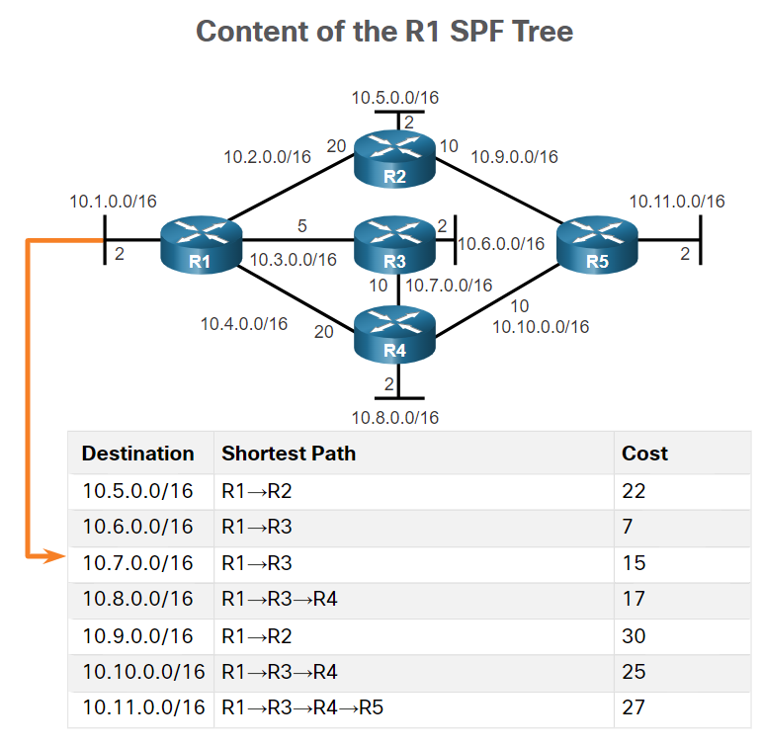
Choose the Best Route
Recap
Open Shortest Path First (OSPF)
2.1 Establish Neighbor Adjacencies
2.2 Exchange Link-State Advertisements
2.3 Build the Link State Database
2.4 Execute the SPF Algorithm
2.5 Choose the Best Route
2.6 OSPF Reference Topology
2.7 Router ID Order of Precedence
3. ACL (Access Control List)
3.1 Wildcard Mask
3.2 Where to Place ACLs
4. NAT (Network Address Translation)
4.1 Static NAT
4.2 Dynamic NAT
4.3 PAT
4.4 PAT Interface
5. Summary

Slide 9
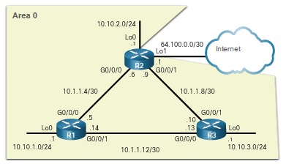
OSPF Reference Topology
Recap
Open Shortest Path First (OSPF)
2.1 Establish Neighbor Adjacencies
2.2 Exchange Link-State Advertisements
2.3 Build the Link State Database
2.4 Execute the SPF Algorithm
2.5 Choose the Best Route
2.6 OSPF Reference Topology
2.7 Router ID Order of Precedence
3. ACL (Access Control List)
3.1 Wildcard Mask
3.2 Where to Place ACLs
4. NAT (Network Address Translation)
4.1 Static NAT
4.2 Dynamic NAT
4.3 PAT
4.4 PAT Interface
5. Summary

Slide 10
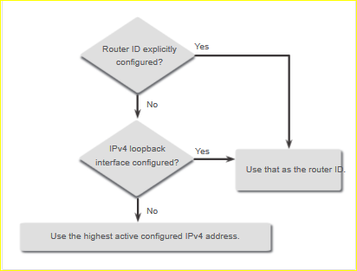
Router ID Order of Precedence
Recap
Open Shortest Path First (OSPF)
2.1 Establish Neighbor Adjacencies
2.2 Exchange Link-State Advertisements
2.3 Build the Link State Database
2.4 Execute the SPF Algorithm
2.5 Choose the Best Route
2.6 OSPF Reference Topology
2.7 Router ID Order of Precedence
3. ACL (Access Control List)
3.1 Wildcard Mask
3.2 Where to Place ACLs
4. NAT (Network Address Translation)
4.1 Static NAT
4.2 Dynamic NAT
4.3 PAT
4.4 PAT Interface
5. Summary

Slide 11
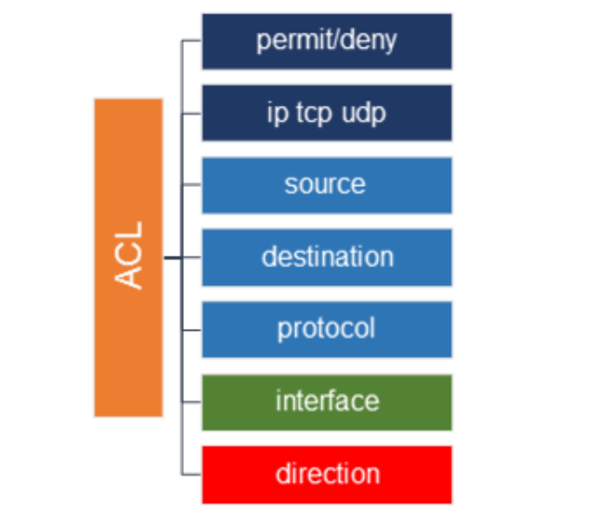
ACL (Access Control List)
Recap
Open Shortest Path First (OSPF)
2.1 Establish Neighbor Adjacencies
2.2 Exchange Link-State Advertisements
2.3 Build the Link State Database
2.4 Execute the SPF Algorithm
2.5 Choose the Best Route
2.6 OSPF Reference Topology
2.7 Router ID Order of Precedence
3. ACL (Access Control List)
3.1 Wildcard Mask
3.2 Where to Place ACLs
4. NAT (Network Address Translation)
4.1 Static NAT
4.2 Dynamic NAT
4.3 PAT
4.4 PAT Interface
5. Summary

Slide 12
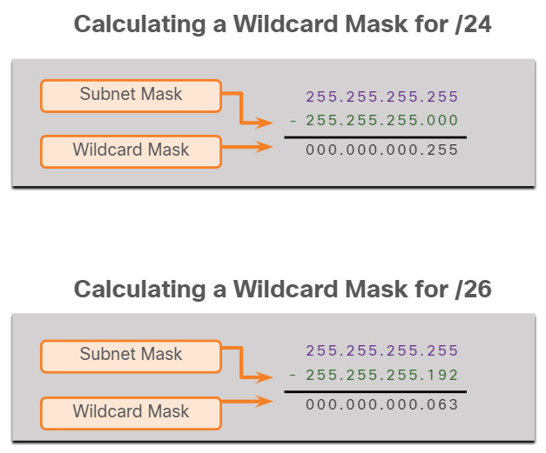
Wildcard Mask
Recap
Open Shortest Path First (OSPF)
2.1 Establish Neighbor Adjacencies
2.2 Exchange Link-State Advertisements
2.3 Build the Link State Database
2.4 Execute the SPF Algorithm
2.5 Choose the Best Route
2.6 OSPF Reference Topology
2.7 Router ID Order of Precedence
3. ACL (Access Control List)
3.1 Wildcard Mask
3.2 Where to Place ACLs
4. NAT (Network Address Translation)
4.1 Static NAT
4.2 Dynamic NAT
4.3 PAT
4.4 PAT Interface
5. Summary

Slide 13
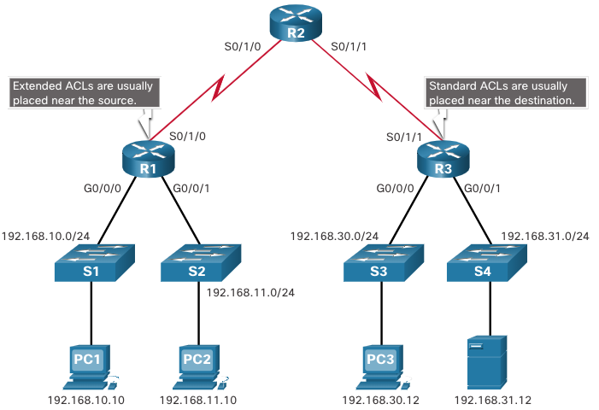
Where to Place ACLs
Recap
Open Shortest Path First (OSPF)
2.1 Establish Neighbor Adjacencies
2.2 Exchange Link-State Advertisements
2.3 Build the Link State Database
2.4 Execute the SPF Algorithm
2.5 Choose the Best Route
2.6 OSPF Reference Topology
2.7 Router ID Order of Precedence
3. ACL (Access Control List)
3.1 Wildcard Mask
3.2 Where to Place ACLs
4. NAT (Network Address Translation)
4.1 Static NAT
4.2 Dynamic NAT
4.3 PAT
4.4 PAT Interface
5. Summary
SDES (Standard Destination Extended Source)

Slide 14
NAT (Network Address Translation)
Recap
Open Shortest Path First (OSPF)
2.1 Establish Neighbor Adjacencies
2.2 Exchange Link-State Advertisements
2.3 Build the Link State Database
2.4 Execute the SPF Algorithm
2.5 Choose the Best Route
2.6 OSPF Reference Topology
2.7 Router ID Order of Precedence
3. ACL (Access Control List)
3.1 Wildcard Mask
3.2 Where to Place ACLs
4. NAT (Network Address Translation)
4.1 Static NAT
4.2 Dynamic NAT
4.3 PAT
4.4 PAT Interface
5. Summary

Slide 15
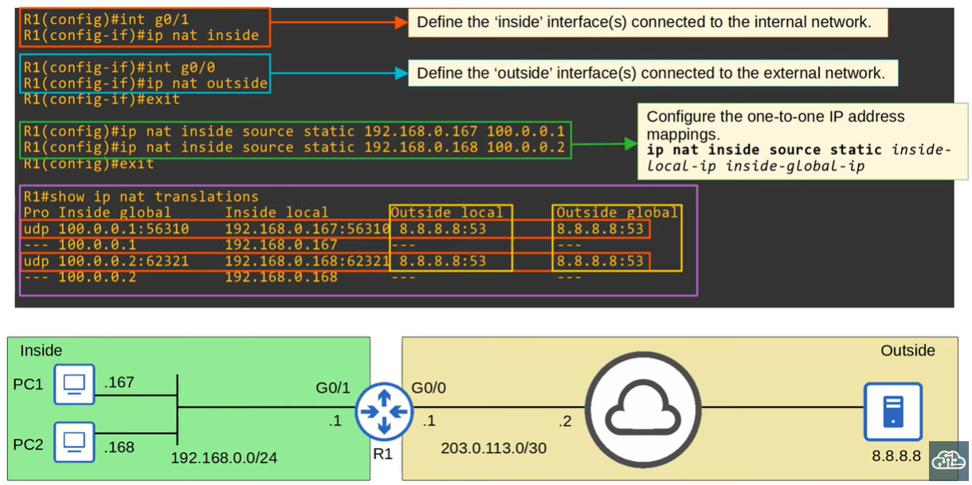
Static NAT
Recap
Open Shortest Path First (OSPF)
2.1 Establish Neighbor Adjacencies
2.2 Exchange Link-State Advertisements
2.3 Build the Link State Database
2.4 Execute the SPF Algorithm
2.5 Choose the Best Route
2.6 OSPF Reference Topology
2.7 Router ID Order of Precedence
3. ACL (Access Control List)
3.1 Wildcard Mask
3.2 Where to Place ACLs
4. NAT (Network Address Translation)
4.1 Static NAT
4.2 Dynamic NAT
4.3 PAT
4.4 PAT Interface
5. Summary

Slide 16
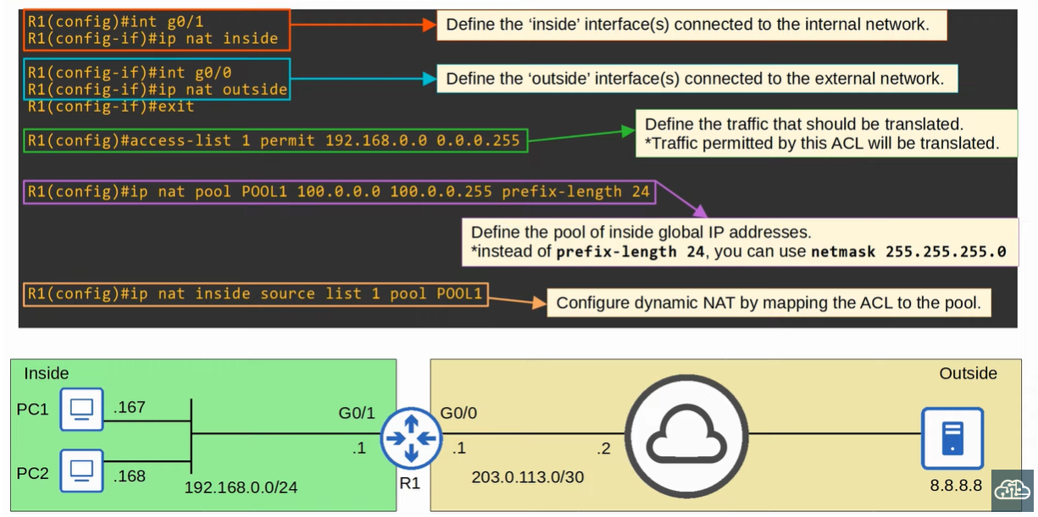
Dynamic NAT
Recap
Open Shortest Path First (OSPF)
2.1 Establish Neighbor Adjacencies
2.2 Exchange Link-State Advertisements
2.3 Build the Link State Database
2.4 Execute the SPF Algorithm
2.5 Choose the Best Route
2.6 OSPF Reference Topology
2.7 Router ID Order of Precedence
3. ACL (Access Control List)
3.1 Wildcard Mask
3.2 Where to Place ACLs
4. NAT (Network Address Translation)
4.1 Static NAT
4.2 Dynamic NAT
4.3 PAT
4.4 PAT Interface
5. Summary

Slide 17
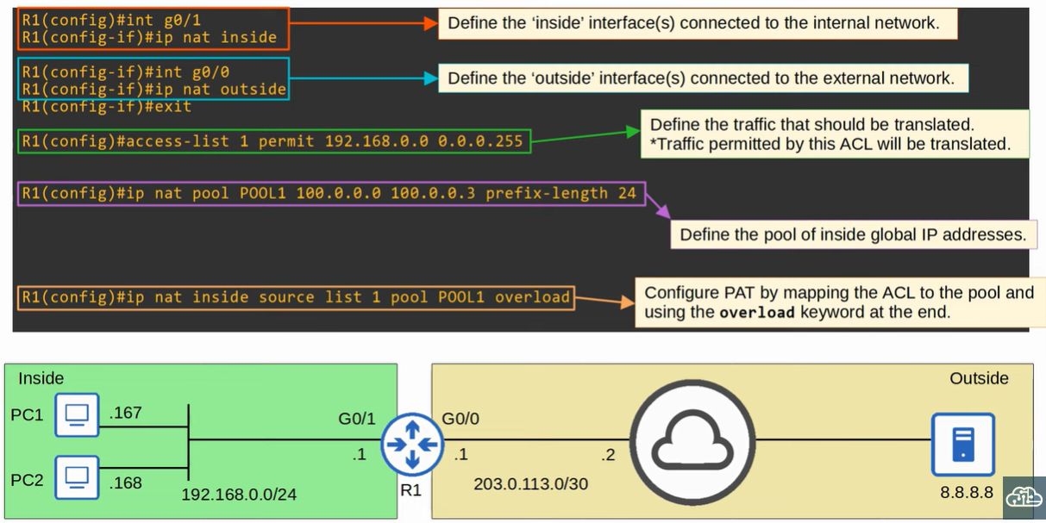
PAT
Recap
Open Shortest Path First (OSPF)
2.1 Establish Neighbor Adjacencies
2.2 Exchange Link-State Advertisements
2.3 Build the Link State Database
2.4 Execute the SPF Algorithm
2.5 Choose the Best Route
2.6 OSPF Reference Topology
2.7 Router ID Order of Precedence
3. ACL (Access Control List)
3.1 Wildcard Mask
3.2 Where to Place ACLs
4. NAT (Network Address Translation)
4.1 Static NAT
4.2 Dynamic NAT
4.3 PAT
4.4 PAT Interface
5. Summary

Slide 18
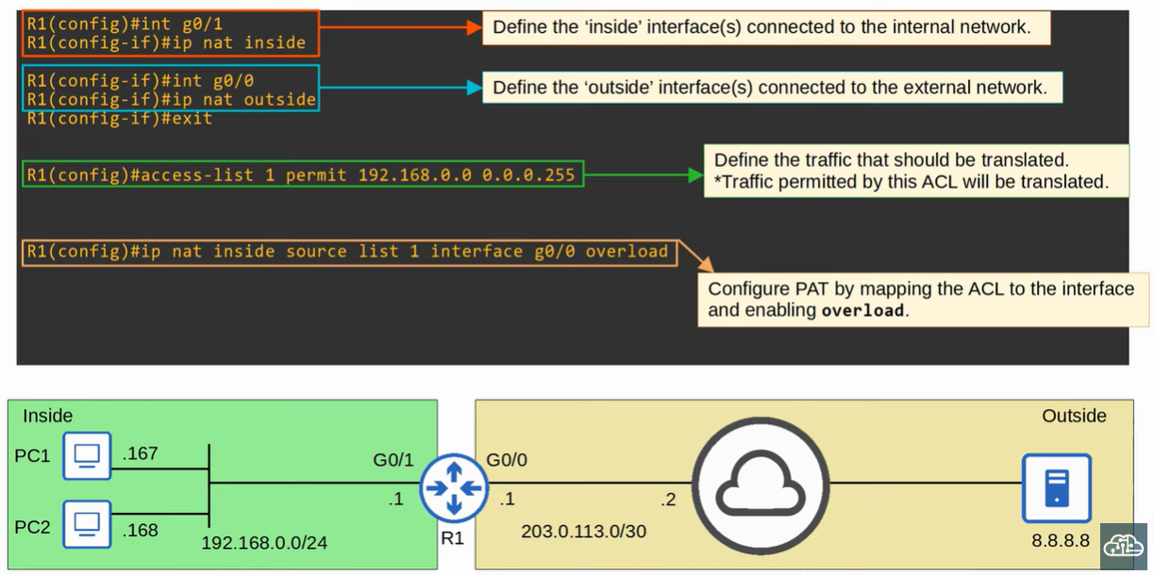
PAT Interface
Recap
Open Shortest Path First (OSPF)
2.1 Establish Neighbor Adjacencies
2.2 Exchange Link-State Advertisements
2.3 Build the Link State Database
2.4 Execute the SPF Algorithm
2.5 Choose the Best Route
2.6 OSPF Reference Topology
2.7 Router ID Order of Precedence
3. ACL (Access Control List)
3.1 Wildcard Mask
3.2 Where to Place ACLs
4. NAT (Network Address Translation)
4.1 Static NAT
4.2 Dynamic NAT
4.3 PAT
4.4 PAT Interface
5. Summary

Slide 19
Summary
Recap
Open Shortest Path First (OSPF)
2.1 Establish Neighbor Adjacencies
2.2 Exchange Link-State Advertisements
2.3 Build the Link State Database
2.4 Execute the SPF Algorithm
2.5 Choose the Best Route
2.6 OSPF Reference Topology
2.7 Router ID Order of Precedence
3. ACL (Access Control List)
3.1 Wildcard Mask
3.2 Where to Place ACLs
4. NAT (Network Address Translation)
4.1 Static NAT
4.2 Dynamic NAT
4.3 PAT
4.4 PAT Interface
5. Summary
Revision of OSPF, ACL and NAT.

